Slide 1


Cyber Security – OT/IoT/IIoT/ ICS/Critical Infrastructure
Sanam Makadia

Slide 2

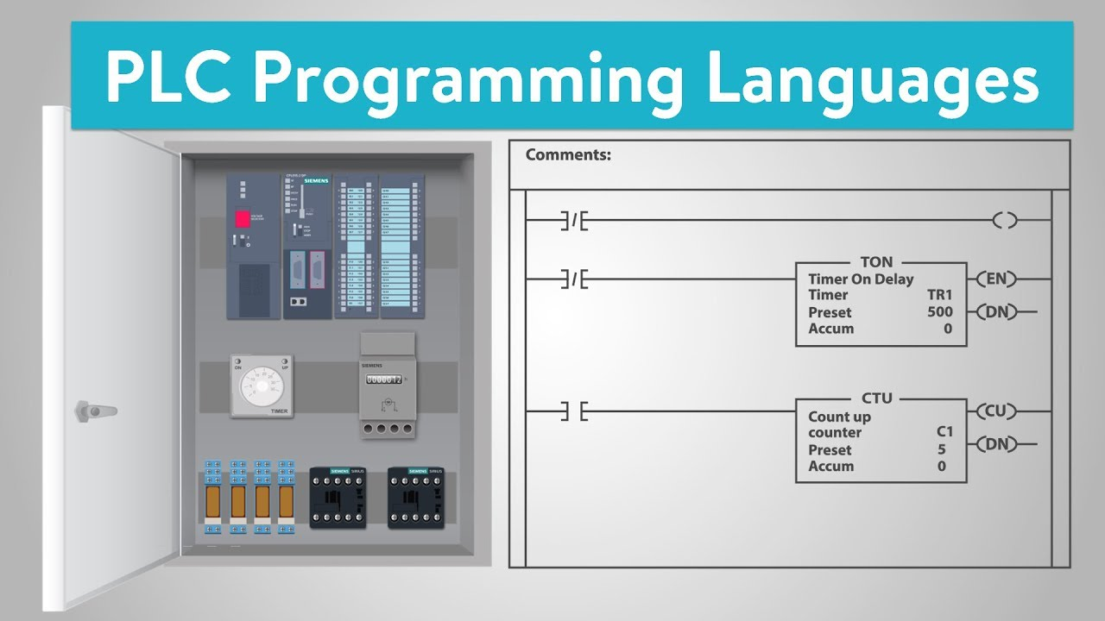
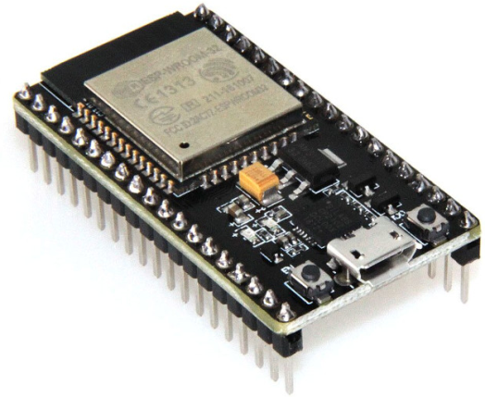


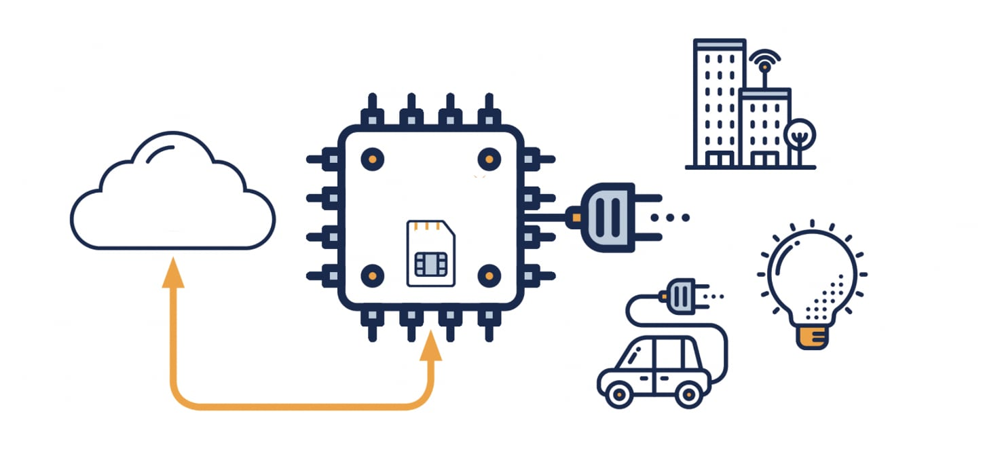

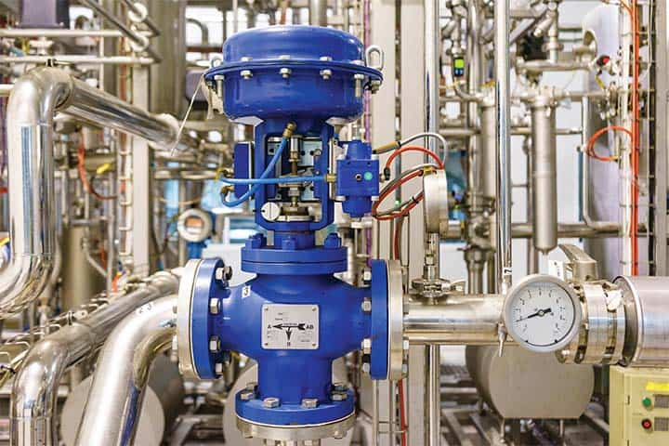

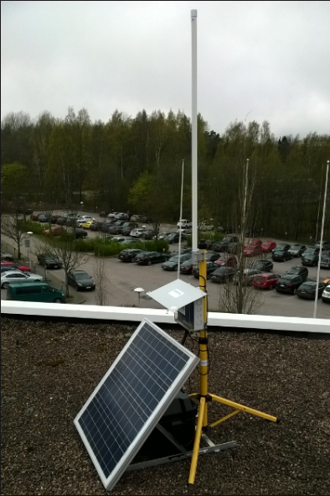
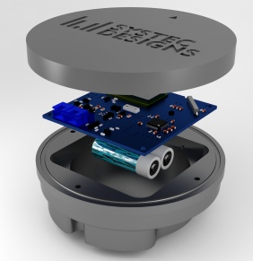
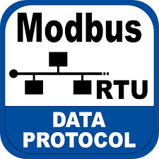
Quick Google search on OT/IoT/IIoT/ICS

Slide 3








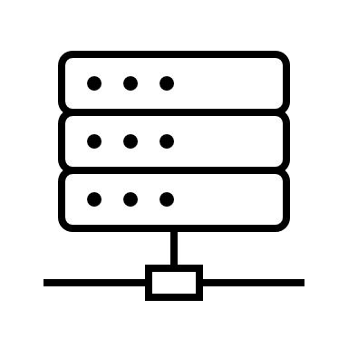
IT & OT/IoT/IIoT/ICS
Industrial Internet of Things (IIoT)
Information Technology (IT)
Internet of Things (IoT)
OT/IoT/IIoT/ICS
Operational Technology (OT)
Industrial Control Systems (ICS)
Supervisory Control and Data Acquisition (SCADA)
Distributed Control System (DCS)
Programmable Logic Controllers (PLCs)

Slide 4
Why Now? (Traditional AIR Gaps are shrinking)
Digital transformation.
Convergence of IT & OT, Cloud Connectivity.
Emergence of Industry 4.0 ecosystem, Data Analytics, Predictive maintenance.
Sophistication of Threats.
Geopolitical tensions.

Slide 5

Communication Protocols
Cloud
Wireless Communication technologies
Short Range | Long Range
 | Cellular | LPWAN
Wifi | 3G (GSM/CDMA) | LoRaWAN
Bluetooth | 4G (LTE) | SIGFOX
Z-Wave | 5G | Weightless-N
Zigbee | LTE Cat 0,1 & 3 | Ingenu
Thread | LTE-M1 | Neul
NFC | LTE-NB1 | N-Wave
RFID | NB-IoT
EnOcean
6LoWPAN
IT (Information technology)
ERP /App / Data Analytic
IP, TCP, UDP, HTTPS,
FTP, SMTP, SNMP
Communication systems & Protocols
SCADA / PLC
OT (Operational technology)
Machine / Sensors / Actuators
Modbus, Profibus, Profinet, BACnet, DALI, DLMS, HART

Slide 6
Issues with OT/ICS security
Proprietary systems managed by engineers (NOT IT).
Not easy to upgrade / patch.
Lack of encryption due to limited memory / processor power.
Specialized communications / protocols.
Systems designed without considering security.
Tailored attacks on physical control components.

Slide 7
C-I-A Triad versus A-I-C Triad
IT Security - Importance is given to sensitive data such as PII, credit card, trade secrets & intellectual property.
ICS/OT Security - Industrial process & Data Integrity is important.
Confidentiality
Availability
Integrity
Integrity
Availability
Confidentiality
IT Security
ICS/OT Security

Slide 8


Purdue Model (Revised from ENISA)
Level 5
SaaS
PaaS
IaaS
Third Parties Services
ERP
Level 4
SCM
S&OP
CRM
MRP
TPS
ESS
Production and supply chain management and planning (manufacturing and enterprise operations)
IIoT Apps
IIoT Platform
Historian
MES
Level 3
WMS
Track & Trace
Dashboards & Displays
Level 2
SCADA
RTUs
PLCs
DCS
HMI
Industrial control and supervision devices and systems
Level 1
IIoT Sensors
IIoT Actuators
SIS
Level 0
Manufacturing Processes and Equipment
Manufacturing processes and machinery

Slide 9





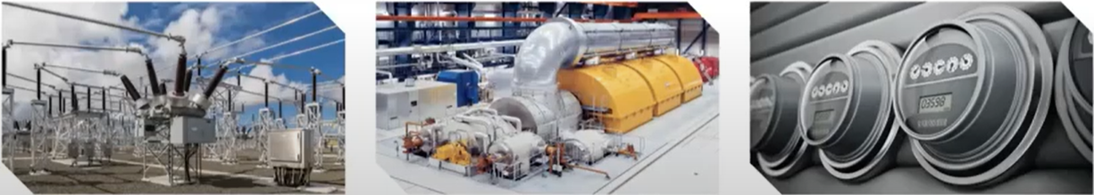
Threat Model
INTERNET
Cybercriminal
Social Engineering
Nation-state, Terrorists
Credential theft
Level 4 or 5: Corporate desktop, Remote access workstation, domain server, webserver
IT Network
Level 1,2 &3: EMS,SCADA, GMS
HMI, Historian, EWS
PLC, IED, RTU, Meter
OT Network
Insider
Cyberphysical Attack
OT Network (EMS, SCADA, GMS)
Side-Channel (Physical)

Slide 10
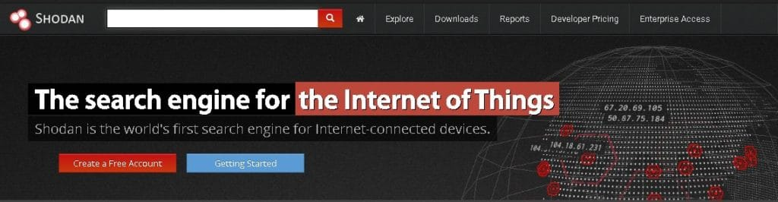

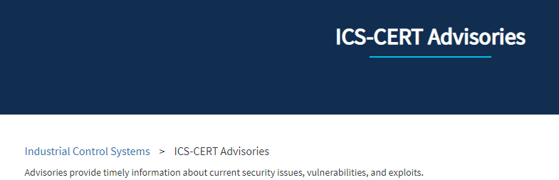
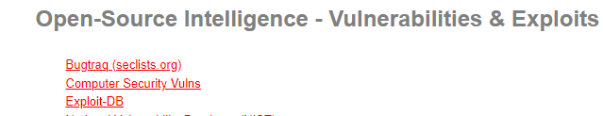
Freely Available Tools
Easily & readily available tools.
OT systems Vulnerability and exploit database.
Search engine like Shodan.
ICS equipment & documentation easy to procure.

Slide 11










OT Infrastructure Attacks
Stuxnet disrupts Iranian nuclear program
Hospital drug infusion pumps hacked
Michigan traffic light hacked
MIRAI Botnet 145,00 IoT devices
Trisis/Triton Malware designed to compromise safety
Ekans ransomware attach on Honda, Fresenius
2001
2013
2015
2017
2019
2021
2010
2014
2016
2018
2020
“Lost Decade”
New York dam floodgates compromised
German steel mill furnace destroyed
Ukraine power grid knocked offline
Maersk Shipping global shutdown
Global Aluminum producer shutdown
ASCO parts shutdown
Colonial Pipeline shutdown
Meat Factory Shutdown

Slide 12
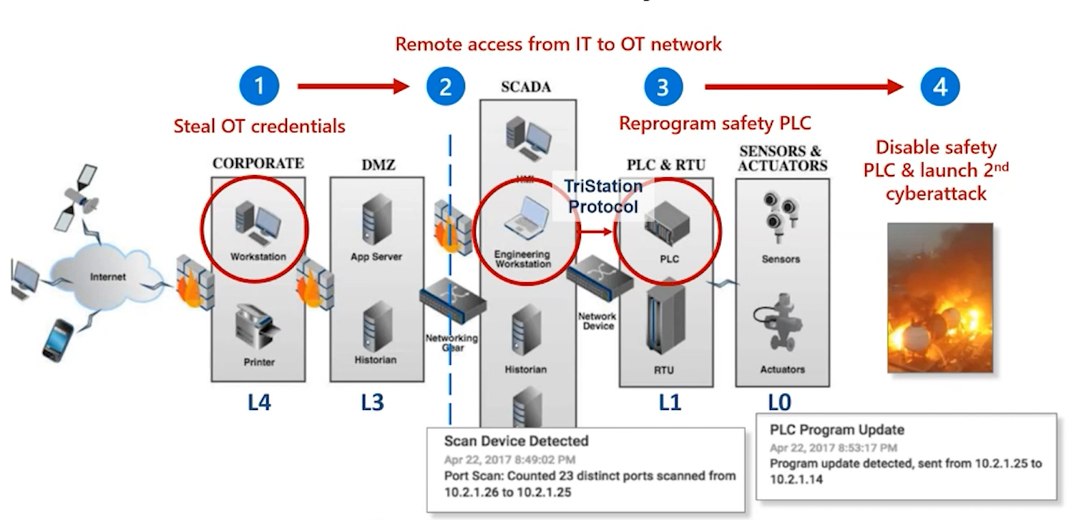
Triton Cyber Attack

Slide 13
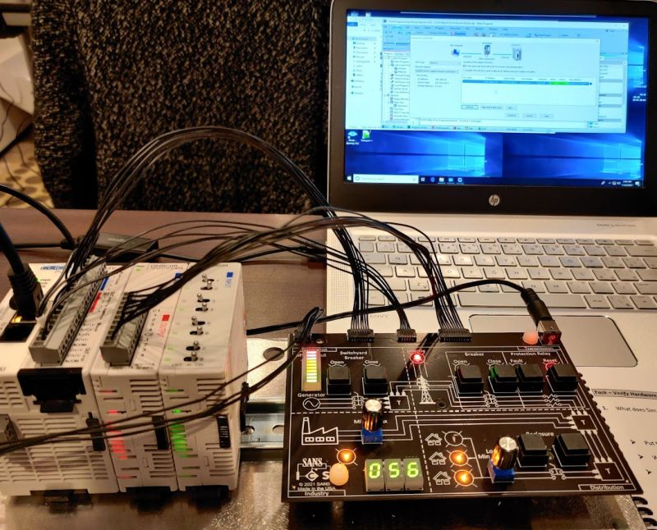
Thinking like Hackers
Information Gathering (Reconnaissance)
Environment Setup
Reverse Engineering
Attack Simulation

Slide 14

Thinking like Defender
Understand what we want to protect (ASSET INVENTORY)
Physical Inventory - Find it & document.
Passive Monitoring - Listen, record traffic and look for assets.
Active Scanning - Scan the network without disruption
Other Sources - Gather data from other network sources / systems.

Slide 15
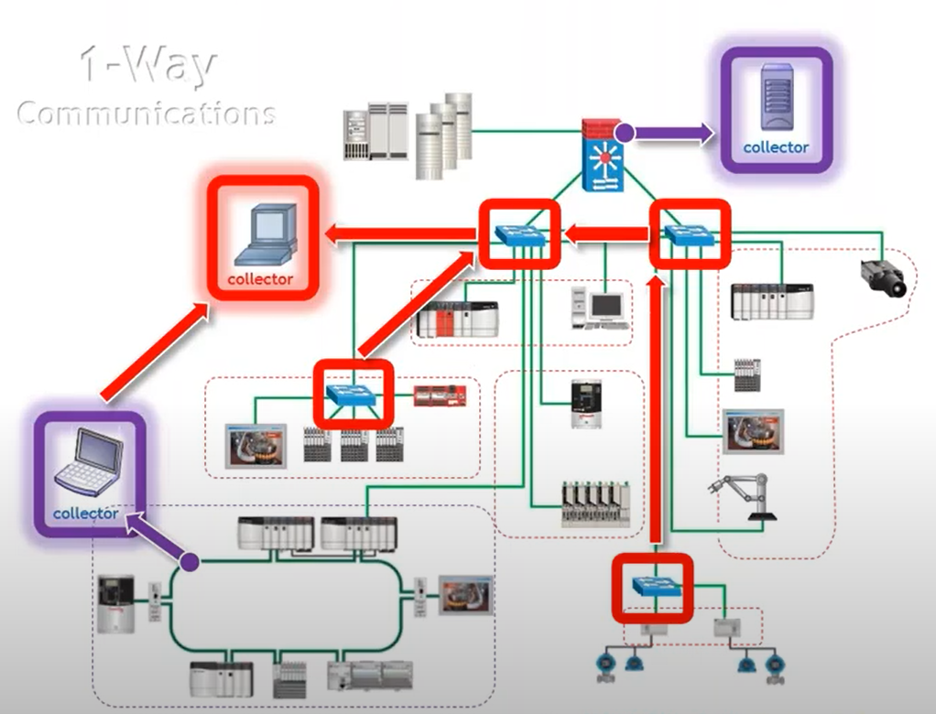
Thinking like Defender
Passive Monitoring & Discovery
Services
SPAN/RSPAN + Hardware TAP.
Limitation
Device & Infrastructure capabilities.
Routing & Segmentation.
Protocol support.
Risks
Configuration Management.
Complex Analysis.
Window for Analysis.

Slide 16
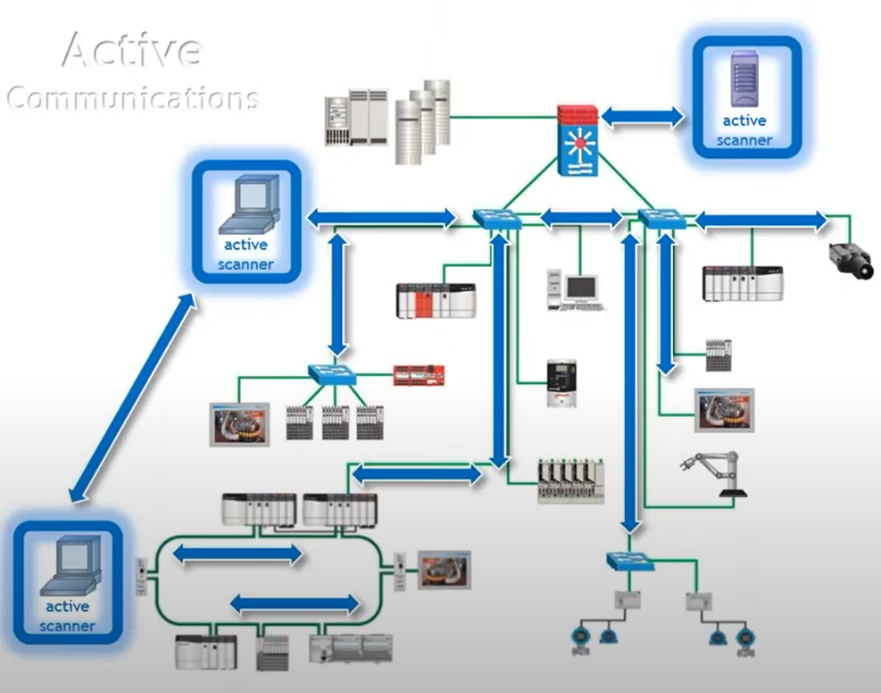
Thinking like Defender
Active Scanning & Discovery
Services
Network Routing.
Device discovery services.
Limitation
Device & Infrastructure capabilities.
Routing & Segmentation.
Protocol support.
Risks
Configuration Management.
Device capability.
Complex Analysis.

Slide 17
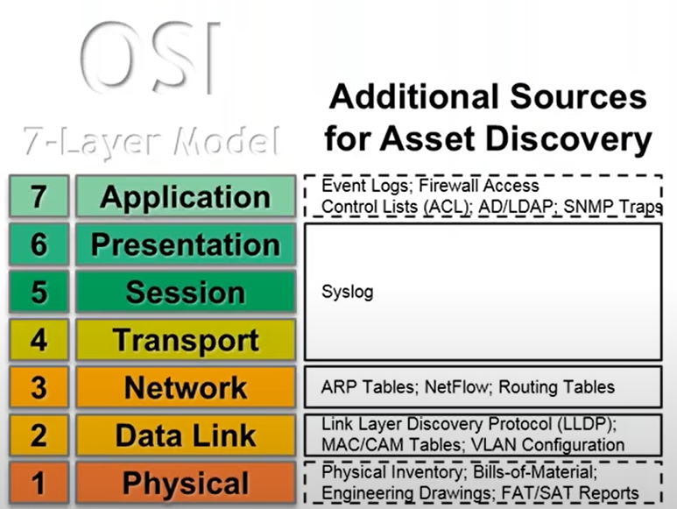
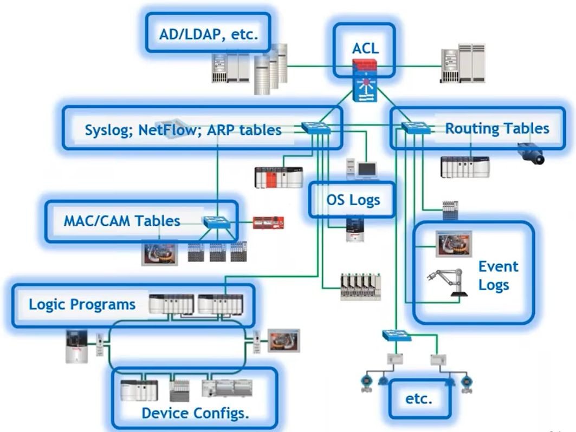
Thinking like Defender
Additional Asset discovery sources & Methods

Slide 18
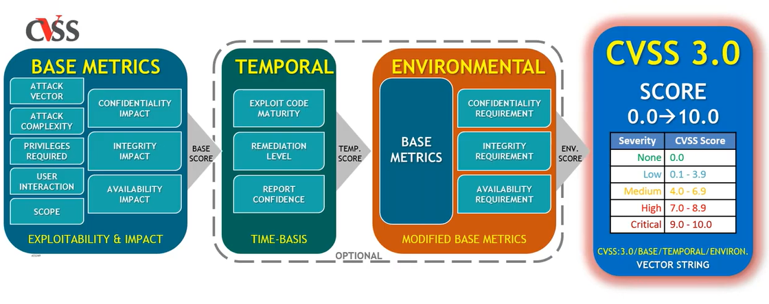
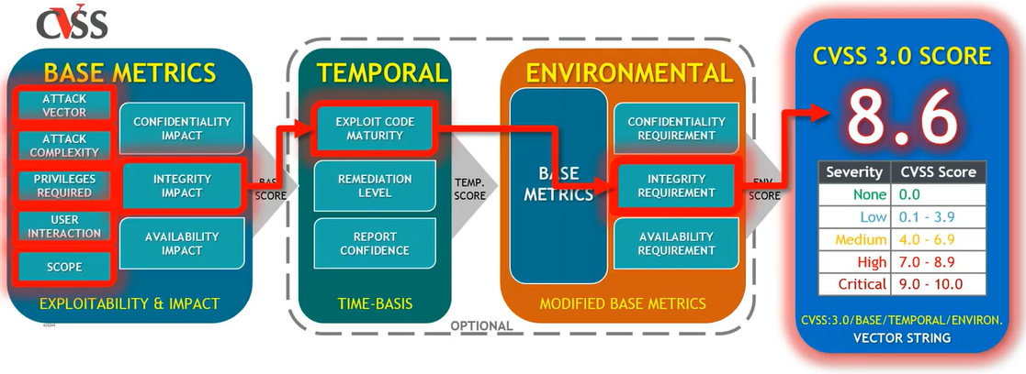
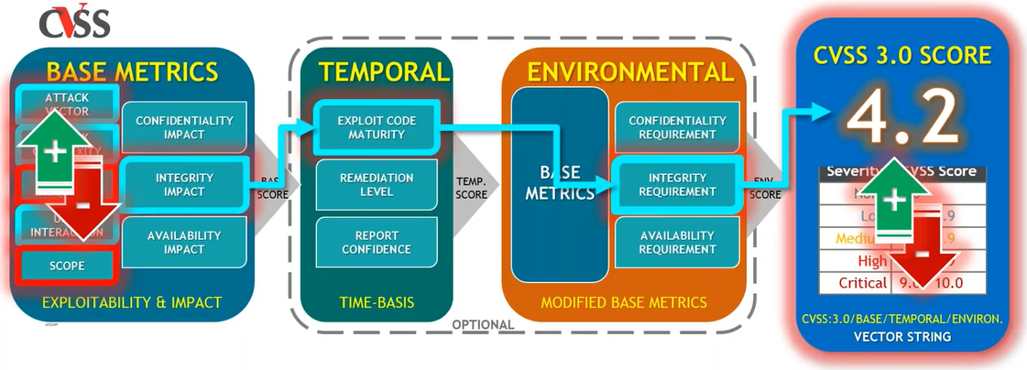
Thinking like Defender
Vulnerability & Patching (To Patch, or Not to Patch?)

Slide 19





Securing with Zero Trust
Data
Identities
Security Policy Engine(s)
Apps & Protocols
Integrated Threat Intelligence
Continuous Risk Evaluation
Infrastructure
Devices
Networking

Slide 20




Zero Trust for OT/IIoT/IoT - recommendations
Implement continuous monitoring.
Detect unauthorized & compromised devices with behavioral anomaly detection.
Implement micro-segmentation using asset discovery & network mapping.
Unify IT & OT security monitoring and governance in SOC.
Leverage MITRA ATT&CK for ICS.
Automate incident response (SOAR).
Apply basic hygiene.
Patch where possible.
Implement MFA.
Train employees.
Verify explicitly.
Implement least privileged access.
Assume compromise.

Slide 21




Agentless security for OT/IoT/IIoT devices
OT/IoT/IIoT Asset Discovery
Operational Efficiency
What devices do we have & whom are they communicating with?
How do we identify the root cause of malfunctioning or misconfigured equipment?
Risk & Vulnerability Management
Unified IT/OT Security Monitoring & Governance
What are risks & mitigations impacting our crown jewel assets?
How do we break down IT/OT silos?
How do we leverage existing workflows & tools to centralize IT/OT security in our SOC?
How do we demonstrate that we have a safety- and security-first environment?
Continuous OT/IoT/IIoT Threat Monitoring, Incident Response & Threat Intelligence
How do we detect & respond to OT/IIoT/IoT threats in the network?

Slide 22




Apply Zero trust Principle to OT/IIoT/IoT
Business Analytics
Cloud Environments
Security Analytics
Blended cybersecurity attacks are driving convergence of IT, OT, and IoT security architectures and capabilities
3rd party
Analytics
Analytics Platform
Dashboard
3rd party
Analytics
SIEM
EDR Console
Operational Technology (OT) Environments
Information Technology (IT) Environments
SAFETY SYSTEMS
Stage 1
Deploy to local site only
Purdue Model
Stage 2
Connect to Cloud
Read-Only
Business Analytic Sensor(s)
Level 3 – Site Operations Control & monitoring for physical site with multiple functions (e.g. plant)
PCAP
(manual)
Purdue Levels 4 + 5 and Zero Trust
MONITOR
MANAGE
Business Analytics
NETWORK TAP/SPAN
NIC1
IoT Sensor(s) + Analytics
NIC2
Level 2 – Supervisory Control Monitoring & Control for discrete business functions (e.g. production line)
IoT Manager
Central Console
Configuration Backups
Plant Security and Operator Consoles
Level 1 – Basic Control Electronics controlling or monitoring physical systems
Local SIEM
(Optional)
Isolation and Segmentation
Level 0 – Process Physical machinery
Internal isolation
As business processes allow
Hard Boundary
Physically disconnect from IT network(s)
Data-Diode (1-way)
Soft(ware) Boundary
People, Process, and Tech (network + identity access control, boundary patching and security hygiene)
EDR Solution
Stage 3
Response Actions (SOAR)
NGFW Management
Zero Trust Principles - Assume breach, verify explicitly, Use least privilege access (identity and network)

Slide 23

Thank you

